Slide 1
Landing Zones for small and growth designs

Slide 2
Creating accessible content
Take the following steps to create accessible content that everyone can consume effectively.
Contrast
Use high contrast colors for maximum readability
The recommended contrast ratio is at least 4.5:1
Color Contrast Analyzer
Download this tool to determine the legibility of text and the contrast of visual elements
Shape and color
Use different shapes with a legend to indicate statuses to accommodate for color blindness
Example:
Alt text
Alt text helps people with screen readers understand the content of slides
You can create alternative text for shapes, pictures, charts, tables, SmartArt graphics, or other objects
Here’s how:
Right click the image or shape
Select Format Picture… or Format Shape…
Select the Size & Properties icon
Expand the Alt Text field
Enter a Title and Description of your image or object
Slide layouts
Using a built-in slide layout that matches your content ensures a hierarchical reading order of text blocks
Example:
If a new slide will have a title, rather than starting with a blank layout and adding a text block for the title, choose one of the built-in layouts with a title placeholder
Reading order
Screen readers describe content on the screen in the order it was created
To ensure your content is read back in the order you prefer, arrange your objects in the Selection Pane appropriately. Objects on the bottom of the selection pane are read first
Here’s how:
Click the Home tab
In the Drawing group, select the Arrange drop-down menu
Click Selection Pane…
Text
Text
Text
Subject 1
Subject 2
Subject 3
Download
C1
C2
C3
Additional tips!
Be sure to run the Accessibility Checker! Go to File click the Check for Issues drop down menu click Check Accessibility
Videos need to be accessible: If your presentation includes a video, ensure it is captioned and audio described (if appropriate)
Visit the Office Accessibility Center to learn more about accessibility in PowerPoint

Slide 3
Abstract and learning objectives
In this whiteboard design session, you will look at how to design landing zones for
Azure at a small deployment that can grow. Your focus will be on a small to
medium size company scenario, where they are looking to move into a cloud and
utilize features for future implementations.
At the end of the workshop, you will be better able to design and use core design
principals for landing zones with Azure, including compute, networking, storage,
data, role-based access, and hybrid cloud pieces. You will also understand how
to utilize Azure resources and best practices as well as better understand the
challenges involved in managing and growing Azure solutions.

Slide 4
Step 1: Review the customer case study
Outcome
Analyze your customer needs
Timeframe
15 minutes

Slide 5
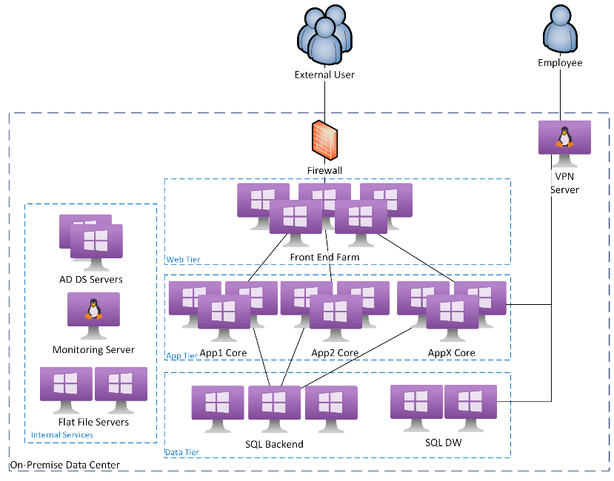
Customer situation
Contoso Excursions
In-house and customer applications & data
Keep secure and available 100% of time
As business grows, scale your operations
All in house managed
Equipment near end of lease
Hardware 80% utilization during business hours
Sporadic timeouts at peak times
Migrate solution to the cloud
Ensure reliable dynamic growth & shrink depending on demand
Application update time frame beyond pending hardware refresh
Development environment
Minimal client interruption
Notes:
As Directory of Information Technology for Contoso Excursions, you are responsible for keeping all your in-house and customer applications & services healthy, secure and available 100% of the time. As your business grows, you need to scale your operations activities accordingly—but you can only use the resources your already have.
Currently, your team manages all technology equipment and customer connectivity--so as the number of customers grows, so does your workload. Your hardware is already frequently maintaining 80% utilization during business hours and clients report sporadic timeouts at peak times. The budgeted plan was only expected to refresh the hardware at the end of the year when the current lease ends.
Your challenge is to migrate your solution to the cloud to ensure reliable, dynamic growth and shrink depending on user demand. However, the estimated time frame to update the application is beyond the time for the pending hardware refresh. You need to create a reliable plan to migrate your infrastructure to the cloud while providing a development environment for the application refresh moves forward and execute the plan with minimal client interruption.

Slide 6
Customer needs
Access to resources must be limited to only the required staff
Least privilege required.
Allow third parties access for support
Backed up on a daily basis.
Critical systems must be available in the event of a disaster
RTO: 12 hours
RPO: 4 hours
Infrastructure must allow for growth of capacity
Allow for transition of applications for IaaS to PaaS
All systems must have the ability to be patched and kept up to date
Centralized reporting to security services for reporting and monitoring.
Monitor performance and availability of systems and applications
Ensure client experience is consistent.
Trends and troubleshooting information should be available for support and development groups
Cost Management
Reporting of the costs should be able to tie back to the individual applications.
Migrations to the cloud should allow for minimum downtime
Enough redundancy to allow for planned patching, updating, and deployment without downtime
Notes:
1. **Management Access** Access to resources must be limited to only the staff that is required and at the least privilege required. There should be options for third parties to have limited access to only those resources they need for support or development.
2. **Backup and Disaster recovery** All data and virtual machines need to be backed up on a daily basis. In addition, the critical systems must be to continue in the event of a disaster within 12 hours (RTO) with no more than a 4 hours of data loss (RPO).
3. **Growth and Expansion** The design of the infrastructure must allow for growth of capacity to process increase in demand of resources as well as expand storage for data as historical information is retained for long term storage. In addition, the design must allow for the transition of applications for IaaS to PaaS as they become available.
4. **Patch Management** All systems must have the ability to be patched and kept up to date with centralized reporting to security services for reporting and monitoring.
5. **VM and Application Monitoring** The performance and availability of systems and applications must be monitored to ensure client experience is consistent. Also, trends and troubleshooting information should be available to support to help users and development group to improve features.
6. **Cost Management** As applications expand and grow, the costs to run those applications will often increase. The reporting of the costs should be able to tie back to the individual applications.
7. **Minimize Downtime** The migrations to the cloud should allow for minimum downtime to the applications as they transition between environments. More over, the solution should encompass enough redundancy to allow for planned patching, updating, and deployment without downtime.

Slide 7
Customer objections
Reliability is a concern
Support people throughout the world
Look to achieve 99.95% SLA where possible
Application performance optimized wherever the user is
Cost is an ongoing concern
Cost-efficient
Break down costs to parse application costs
Final solution should be able to scale up and down based on demand.
Security is a major concern
Users' personal identity information (PII) must be kept confidential and secure
Notes:
1. Reliability is a concern as their business support people throughout the world. Service goals should look to achieve 99.95% SLA where possible. In addition, the final application services should be optimized for performance regardless of where the user is in the world.
2. Cost is an ongoing concern for the enterprise. Solutions should not only be cost-efficient, but should be able to easily break down costs to individual regions for reports and parse application costs where possible. In addition, the final solution should be able to scale up and down depending on the current demand.
3. Security is a major concerns for the company. Users' personal identity information (PII) must be kept confidential and secure from both people outside the organization, as well as personnel within the company that do not need access for their work.

Slide 8
Step 2: Design the solution
Outcome
Design a solution and prepare to present the solution to the target customer audience in a 15-minute chalk-talk format.
Timeframe
60 minutes
Business needs (10 minutes) | Respond to questions outlined in your guide and list the answers on a flipchart
Design (35 minutes) | Design a solution for as many of the stated requirements as time allows. Show the solution on a flipchart
Prepare (15 minutes) | Identify any customer needs that are not addressed with the proposed solution Identify the benefits of your solution Determine how you will respond to the customer’s objections Prepare for a 15-minute presentation to the customer

Slide 9
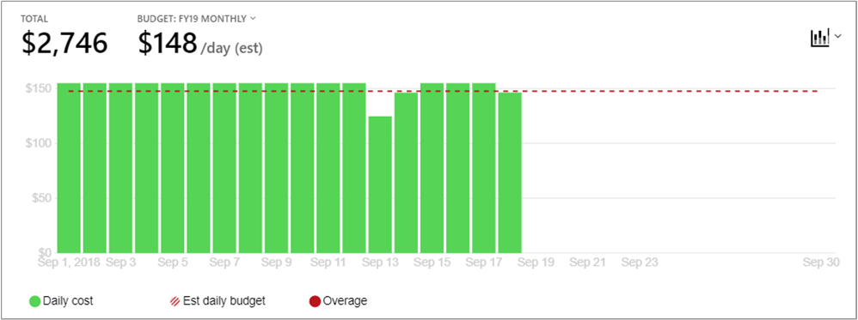
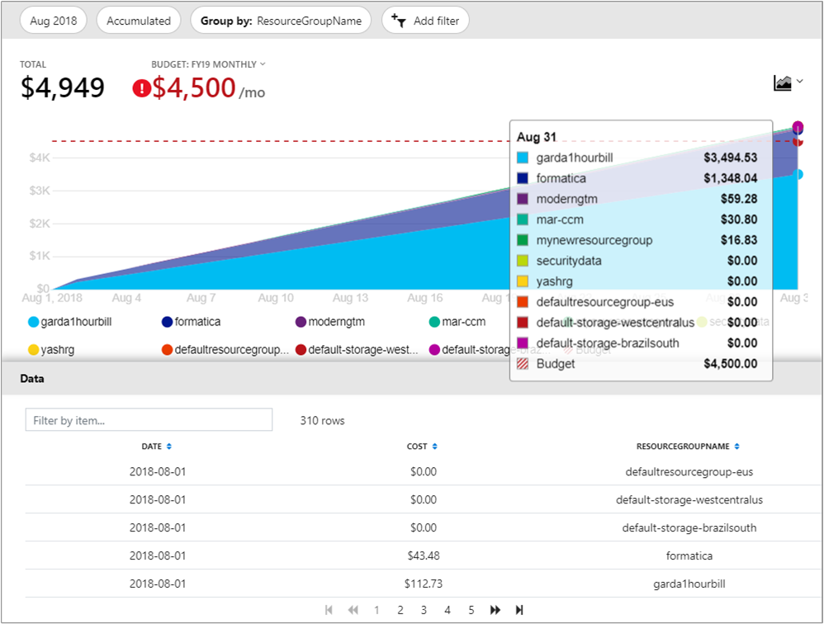
Common scenarios
Azure cost management
Understand where costs originate
Set budgets and alerts
Roll up reports across the organization with management groups
Delegated access to reports and usage

Slide 10
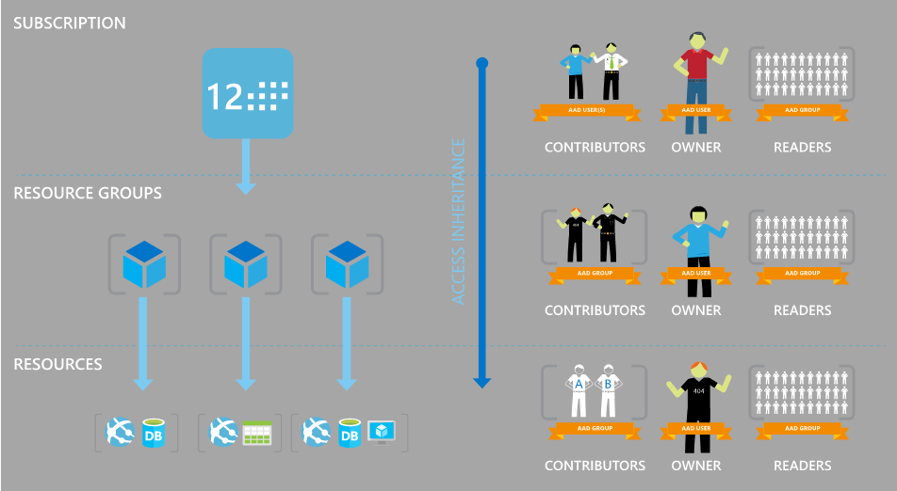

Common scenarios
Role-based access control (RBAC) and Azure policy
Governance of Azure resources
Granular access control

Slide 11


Common scenarios
Azure blueprints
Automated provisioning of entire environments
Deployment tracking and updates
Optional locking against unauthorized changes
Role-based access controls
Policy Definitions
Subscription A
Templates
Azure Blueprints
Subscription B
Subscription C
…

Slide 12
Step 3: Present the solution
Outcome
Present a solution to the target customer in a 15-minute chalk-talk format
Timeframe
30 minutes (15 minutes for each team to present and receive feedback)
Directions
Pair with another table
One table is the Microsoft team and the other table is the customer
The Microsoft team presents their proposed solution to the customer
The customer asks one of the objections from the list of objections in the case study
The Microsoft team responds to the objection
The customer team gives feedback to the Microsoft team

Slide 13
Wrap-up
Outcome
Identify the preferred solution for the case study
Identify solutions designed by other teams
Timeframe
15 minutes

Slide 14
Preferred target audience
Leader | Emma Fox, Founder & CEO
Finances | CFO
Application(s) Owner | Lead of Application Design
Security | Information Security Manager
Notes:
TODO: Provide example target audience

Slide 15
Preferred solution
CAF Blueprint - Migrate landing zone
VNet
Key Vault
Log Analytics
Azure Migrate
RBAC for Access
ASR for DR
Front Door for global access
Policies for standards
Notes:
Start with the CAF Migrate landing zone Blueprint template (https://docs.microsoft.com/en-us/azure/governance/blueprints/samples/caf-migrate-landing-zone/deploy). Add in additional resources to meet needs such as Policies for standards and limitations, ASR for Disaster Recovery and Backup, Front door for CDN and perimeter security, and Cost Management for cost monitoring.
The Log Analytics will feed into Azure Monitor where Alerts, notifications, and dashboards can be configured.

Slide 16



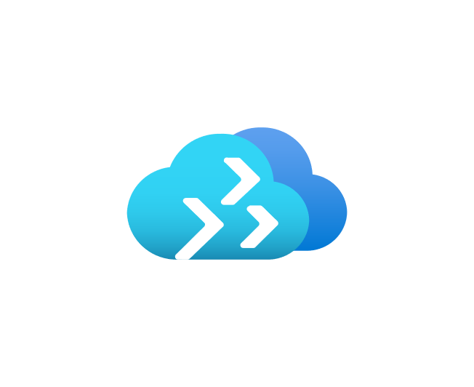

Preferred objections handling
Reliability
99.95% SLA - Availabilty Zones/Sets
Optimized performance over the world - Front door/CDN
Cost
Cost Center configuration and alerts
Tagging enforced via Policy to ensure metadata for reports
Azure Migrate to determine right size of VMs
Security
RBAC and IAM ensure access clearly defined by roles
Guest identies brought in for third-party support ensure simplified management and compliance
Dynamic Data Masking provides security of data within PaaS databases
Notes:
1. Reliability is a concern as their business support people throughout the world. Service goals should look to achieve 99.95% SLA where possible. In addition, the final application services should be optimized for performance regardless of where the user is in the world.
*Response*
The ability to run critical VMs, such as SQL or Application, with Availability Sets will allow the VMs to achieve 99.95% via Azure's SLA. In addition, for added reliability, Azure Zones can allow for SLA's up to 99.99%, but they require some additional setup and not available in all regions. If this is selected, ensure a region that supports Availability Zones were used.
For improved performance regardless of where the user is in the world, Front Door would provide a secure permitter solution with a Content Deliver Network (CDN) to allow for access geographically closer to the end user.
2. Cost is an ongoing concern for the enterprise. Solutions should not only be cost-efficient, but should be able to easily break down costs to individual regions for reports and parse application costs where possible. In addition, the final solution should be able to scale up and down depending on the current demand.
*Response*
Cost reporting is always an important concern in almost all Azure clients' subscriptions. Having cost center configured and alerting will provide the best reporting and active monitoring of costs. Adding metadata with Tags to resources by standard and/or policy can help identify where costs are going.
Using Azure Migration services to help properly identify resource needs ahead of time and allow for right sizing can provide the best option to ensure systems are not oversized. On going monitoring via Azure Monitor can also help identify systems that are over provisioned.
In addition, developing a clear road map to get the application away from costly, generic compute costs like VM into optimized solutions with PaaS pieces can help take advantage of dynamic sizing and growth to get the best performance out of their dollars.
3. Security is a major concerns for the company. Users' personal identity information (PII) must be kept confidential and secure from both people outside the organization, as well as personnel within the company that do not need access for their work.
*Response*
By utilizing RBAC for Azure resources, we can ensure that only those users with defined roles have only the intended access they need to the Azure environment. Furthermore, by utilizing Azure AD, we can allow users to utilize their existing identities and better harden access with those accounts.
In addition, we can bring in identities from partners on an as needed basis via Azure AD B2B with secure communications and defined access while minimizing exposure of our systems and management tasks.
Finally, as the client moves to resources such as Azure SQL to extend RBAC structure and utilize features such as [Dynamic Data Masking](https://docs.microsoft.com/en-us/sql/relational-databases/security/dynamic-data-masking)

Slide 17
Customer quote
“With the provided best practices and well designed
Azure Landing Zones, we were able to quickly bring our
on premise solution to the cloud with reliability and assure
continued service to our clients in a very short time frame
allowing us to focus our resources on growing and
expanding our solution for a dynamic and evolving
technological world.”
- Emma Fox, Founder & CEO of Contoso Excursions
Notes:
TODO: Provide customer quote from success

Slide 19
STOP
Only template slides after this

Slide 20
Text layout (without bullet points)
Main topic 1: size 36pt
Size 28pt for second level
Size 24pt for third level
Size 22pt for fourth level
Size 22 for fifth level

Slide 21
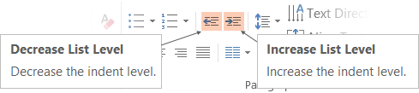
Text with bullet points - adjusting list levels
Main topic 1: size 36pt
Size 28pt for second level
Size 24pt for third level
Size 22pt for fourth level
Size 22 for fifth level
Use the “Decrease List Level” and “Increase List Level” tools on the Home Menu to change text levels.
Try this:
Place your cursor in any row of text to the left that says “Size 20pt for subtopics”
Next click the Home tab, and then on the “Decrease List level” tool. Notice how the line moves up one level.
Now try placing your cursor in one of the “Main topic…” lines of text. Click the “Increase List Level” tool and see how the text is pushed in one level
Use these 2 tools to adjust your text levels as you work

Slide 22
Bullet points layout with subtitle Subtitle is smaller in the same text block
Example of a bulleted slide with a subhead
Set the slide title to “Sentence case”
Set subheads to “Sentence case”
Hyperlink style
www.microsoft.com

Slide 23
Photo layout 1

Slide 24
Demo

Slide 25
Video

Slide 26
Section title

Slide 27
Software code slide
This slide layout uses Consolas, a monotype font which is ideal for showing software code.

Slide 28
Notes (hidden)
Some speakers at Microsoft like to use this slide for hidden “notes slides”.
Delete it if you don’t want to use it.
NEXT: <next slide title>

